Slide 1




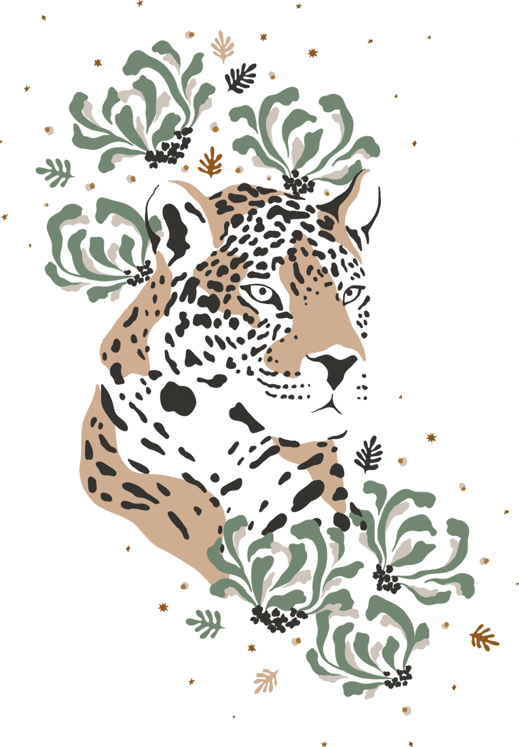










English Year 5
Unit 3 – Wild Life

Slide 2
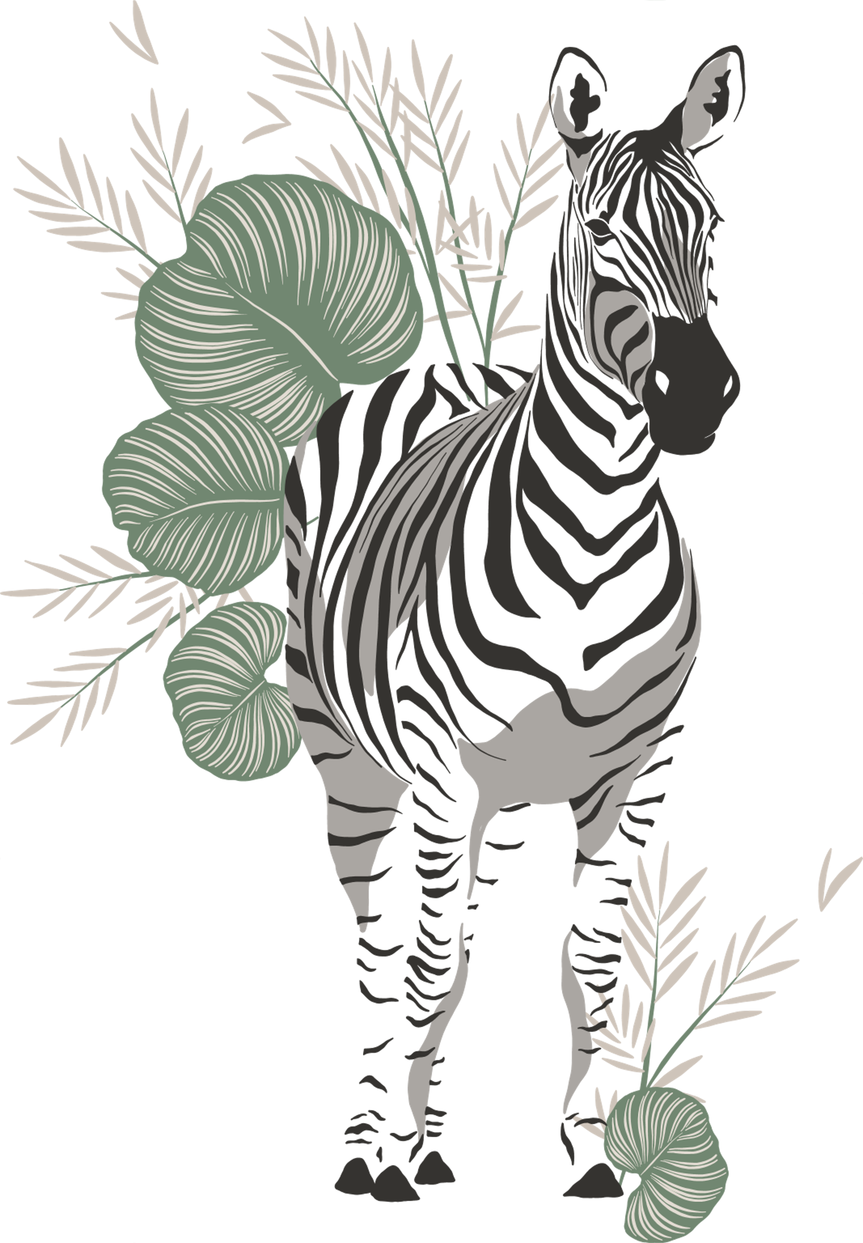
LEARNING
OBJECTIVES
BY THE END OF THE LESSON, PUPILS WILL BE ABLE TO:
Listen and understand details from longer simple text.
Keep interaction going in short exchanges.
Spell a range of high-frequency words accurately in independent writing.
Describe people, places and objects using suitable statements.

Slide 3




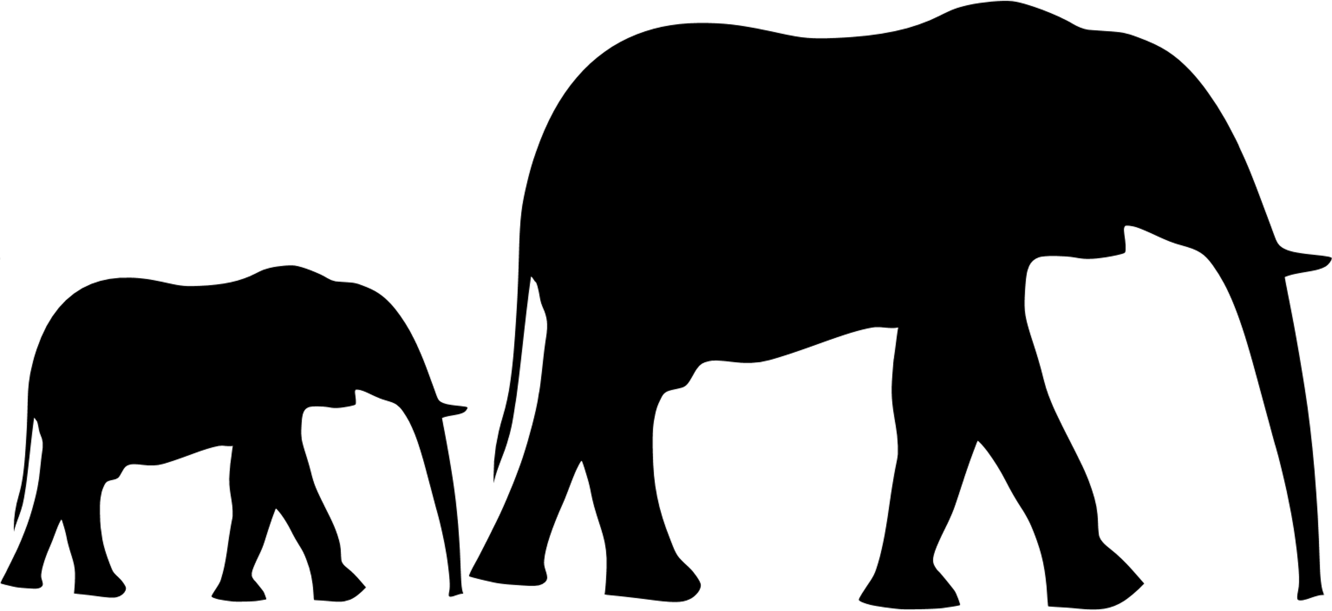
Can You Guess These Animals?

Slide 4
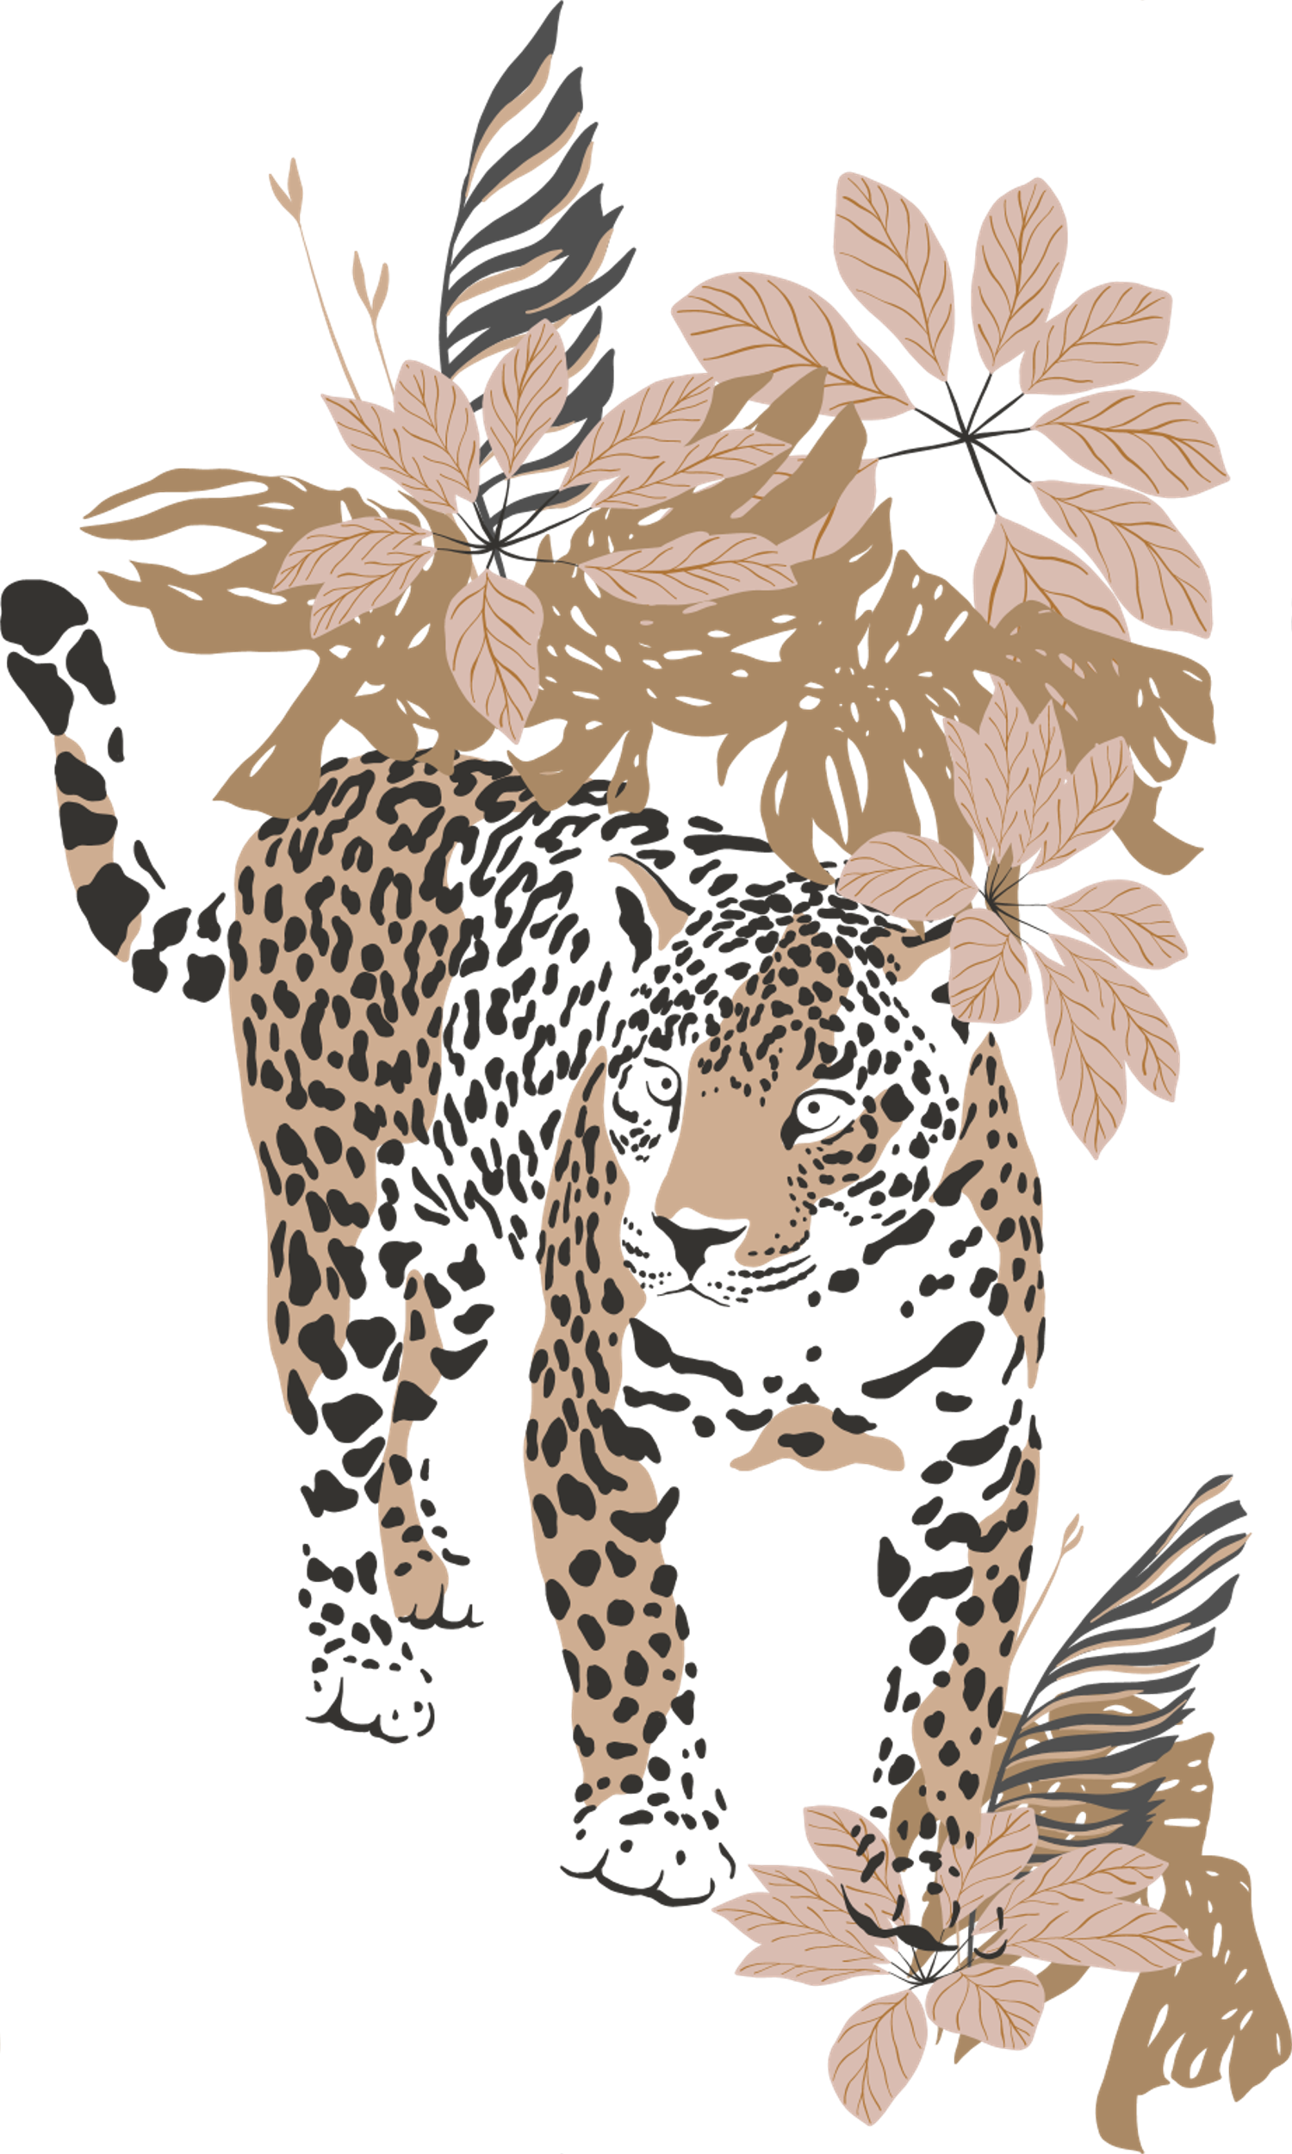
Importance
THE IMPORTANCE OF WILDLIFE
Wildlife plays a crucial role in maintaining the balance of ecosystems.
Wild animals contribute to biodiversity, ensuring a variety of species coexist in their natural habitats.
Wildlife provides essential ecosystem services, such as pollination and seed dispersal, which are vital for the growth of plants and forests.
Protecting wildlife preserves the natural beauty of our planet and allows future generations to appreciate and learn from these unique creatures.

Slide 5
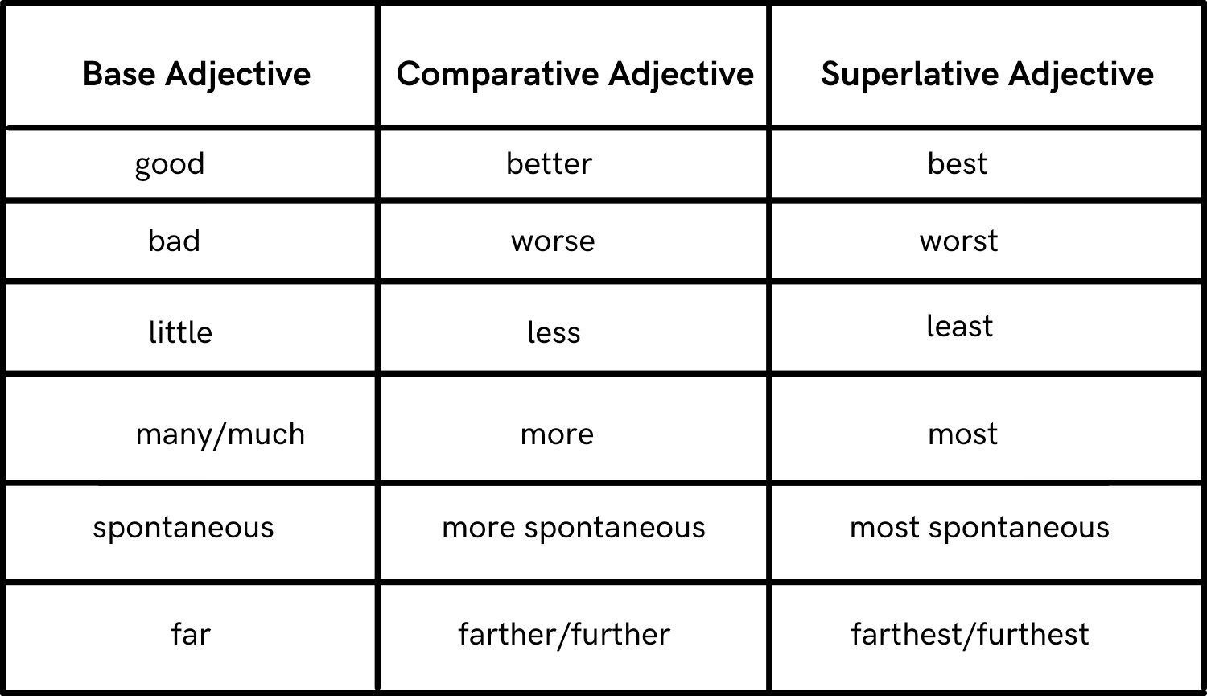

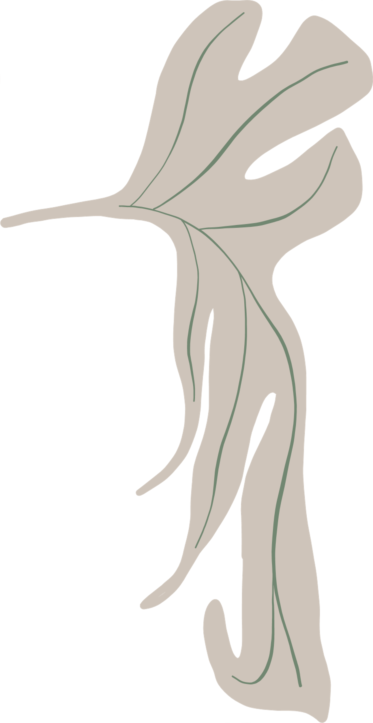



Let's look at some adjectives

Slide 6

Here are some examples
COMPARATIVE ADJECTIVES
Comparative adjectives are used to compare two things or animals.
To form the comparative, we often add "-er" to the adjective or use the word "more."
SUPERLATIVE ADJECTIVE
Superlative adjectives are used to compare three or more things or animals.
To form the superlative, we often add "-est" to the adjective or use the word "most."

Slide 7

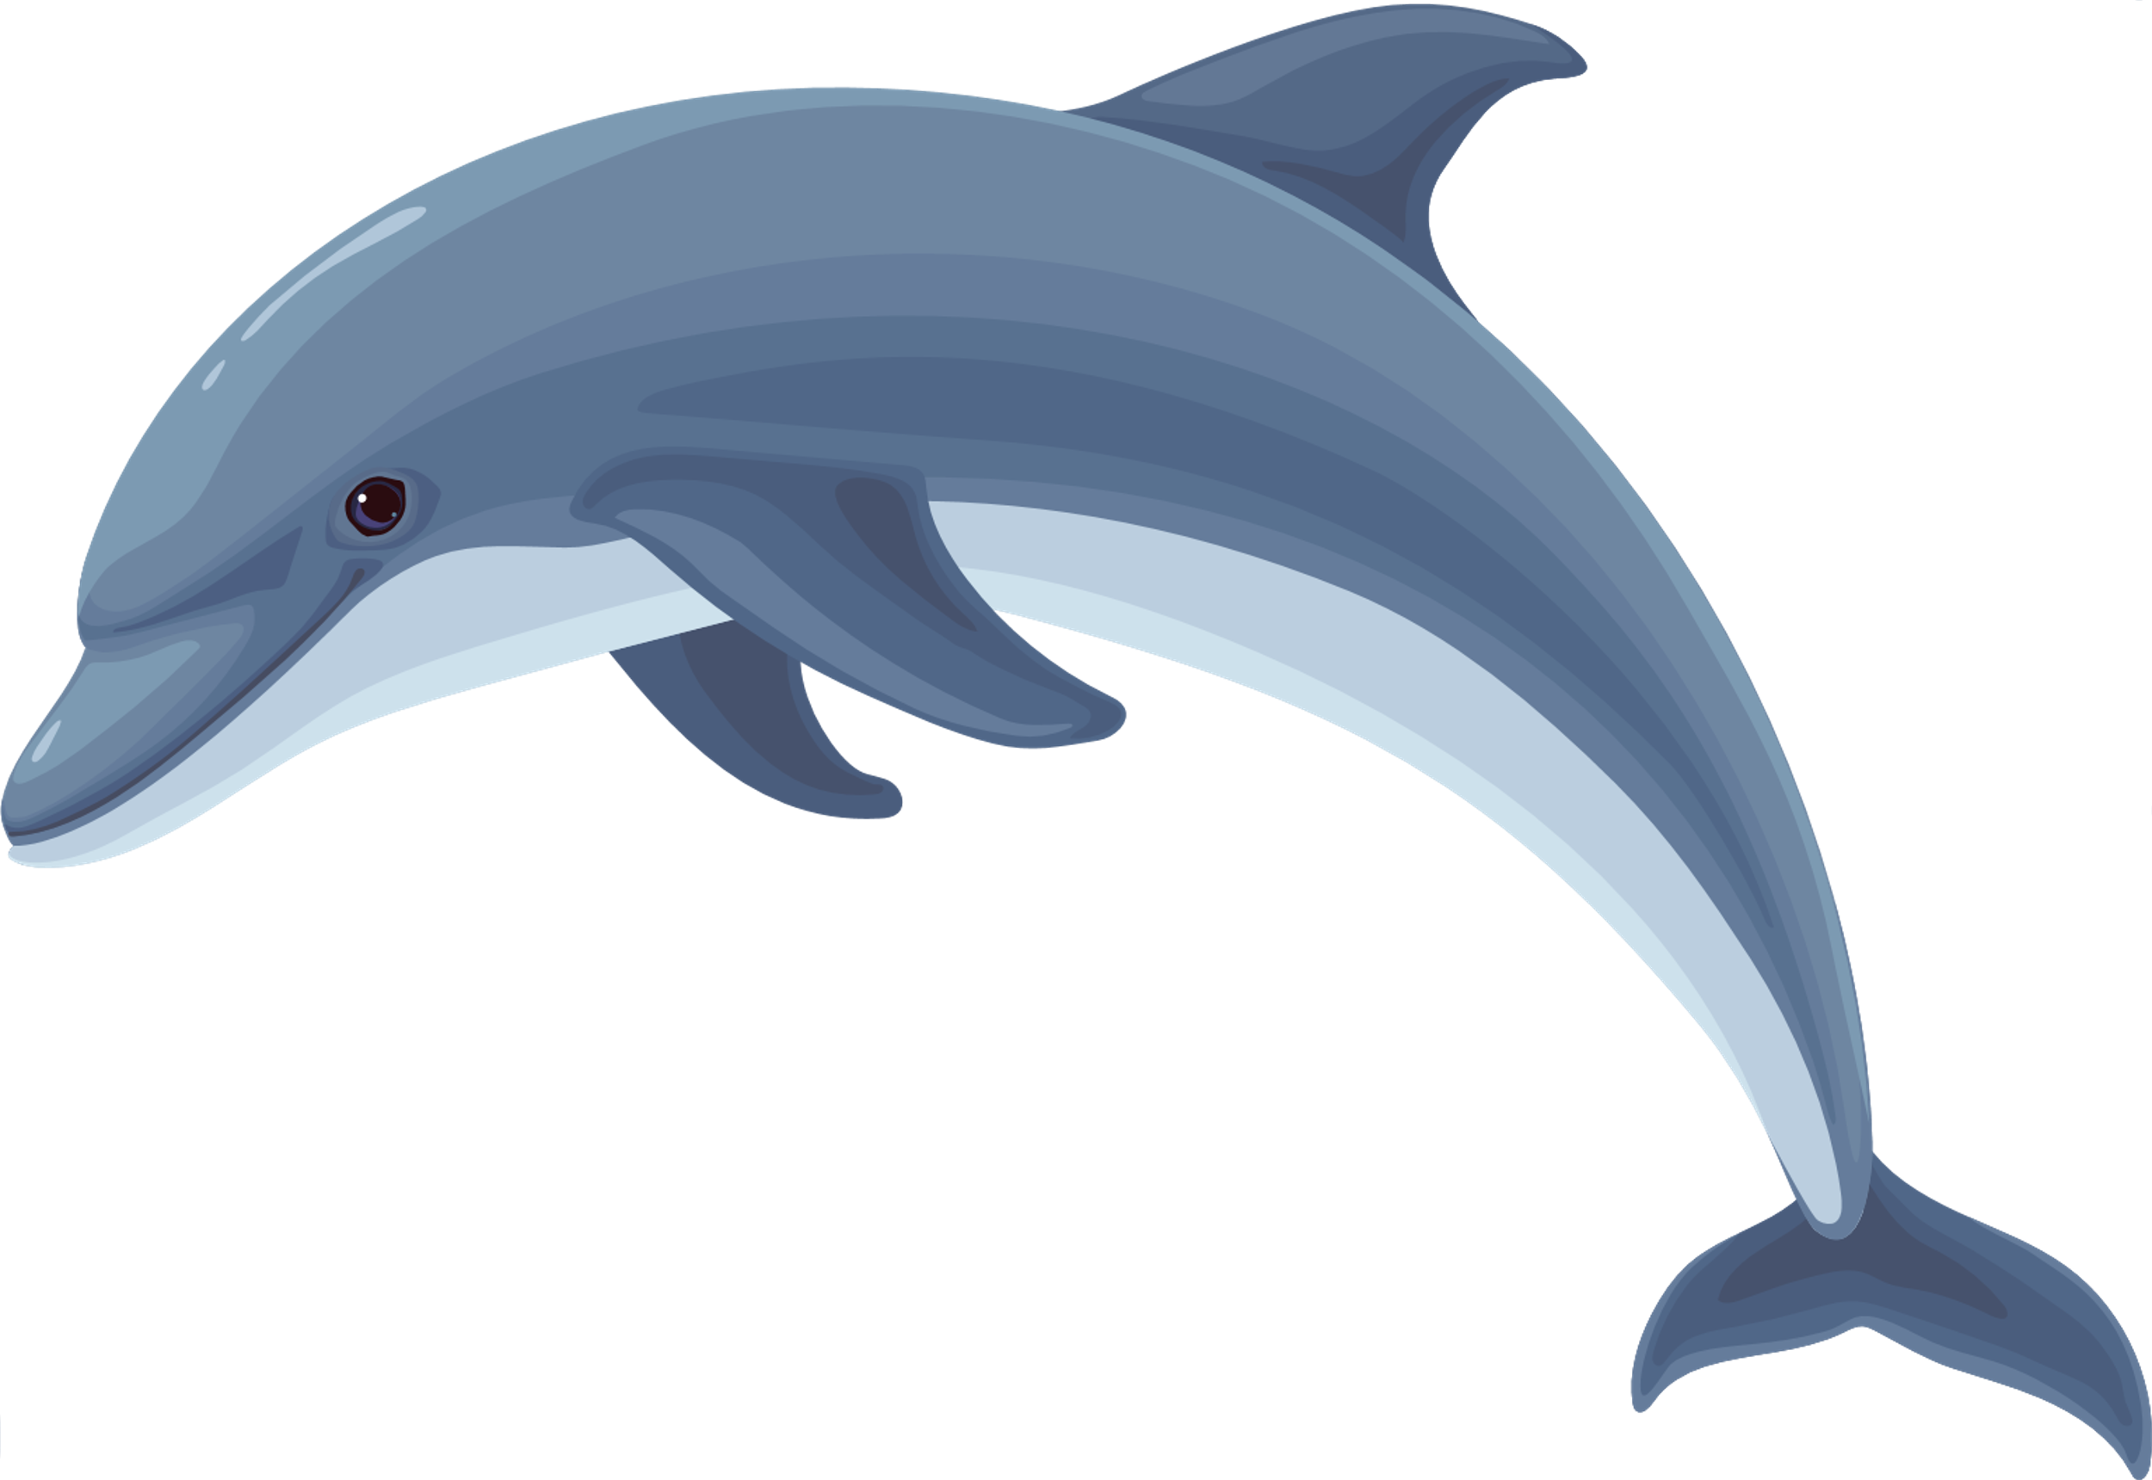
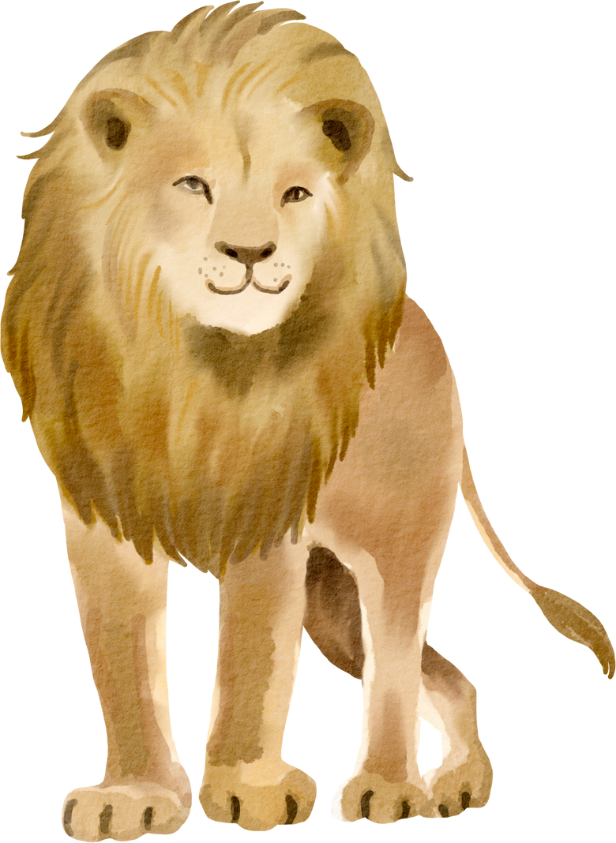
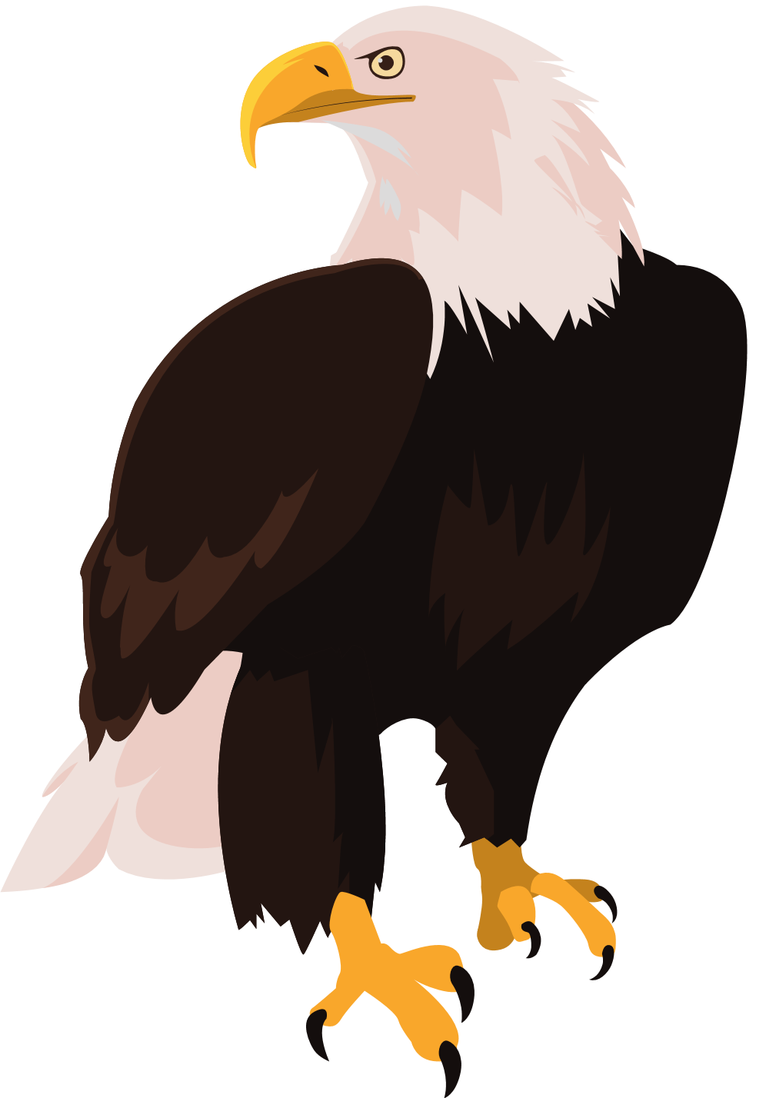
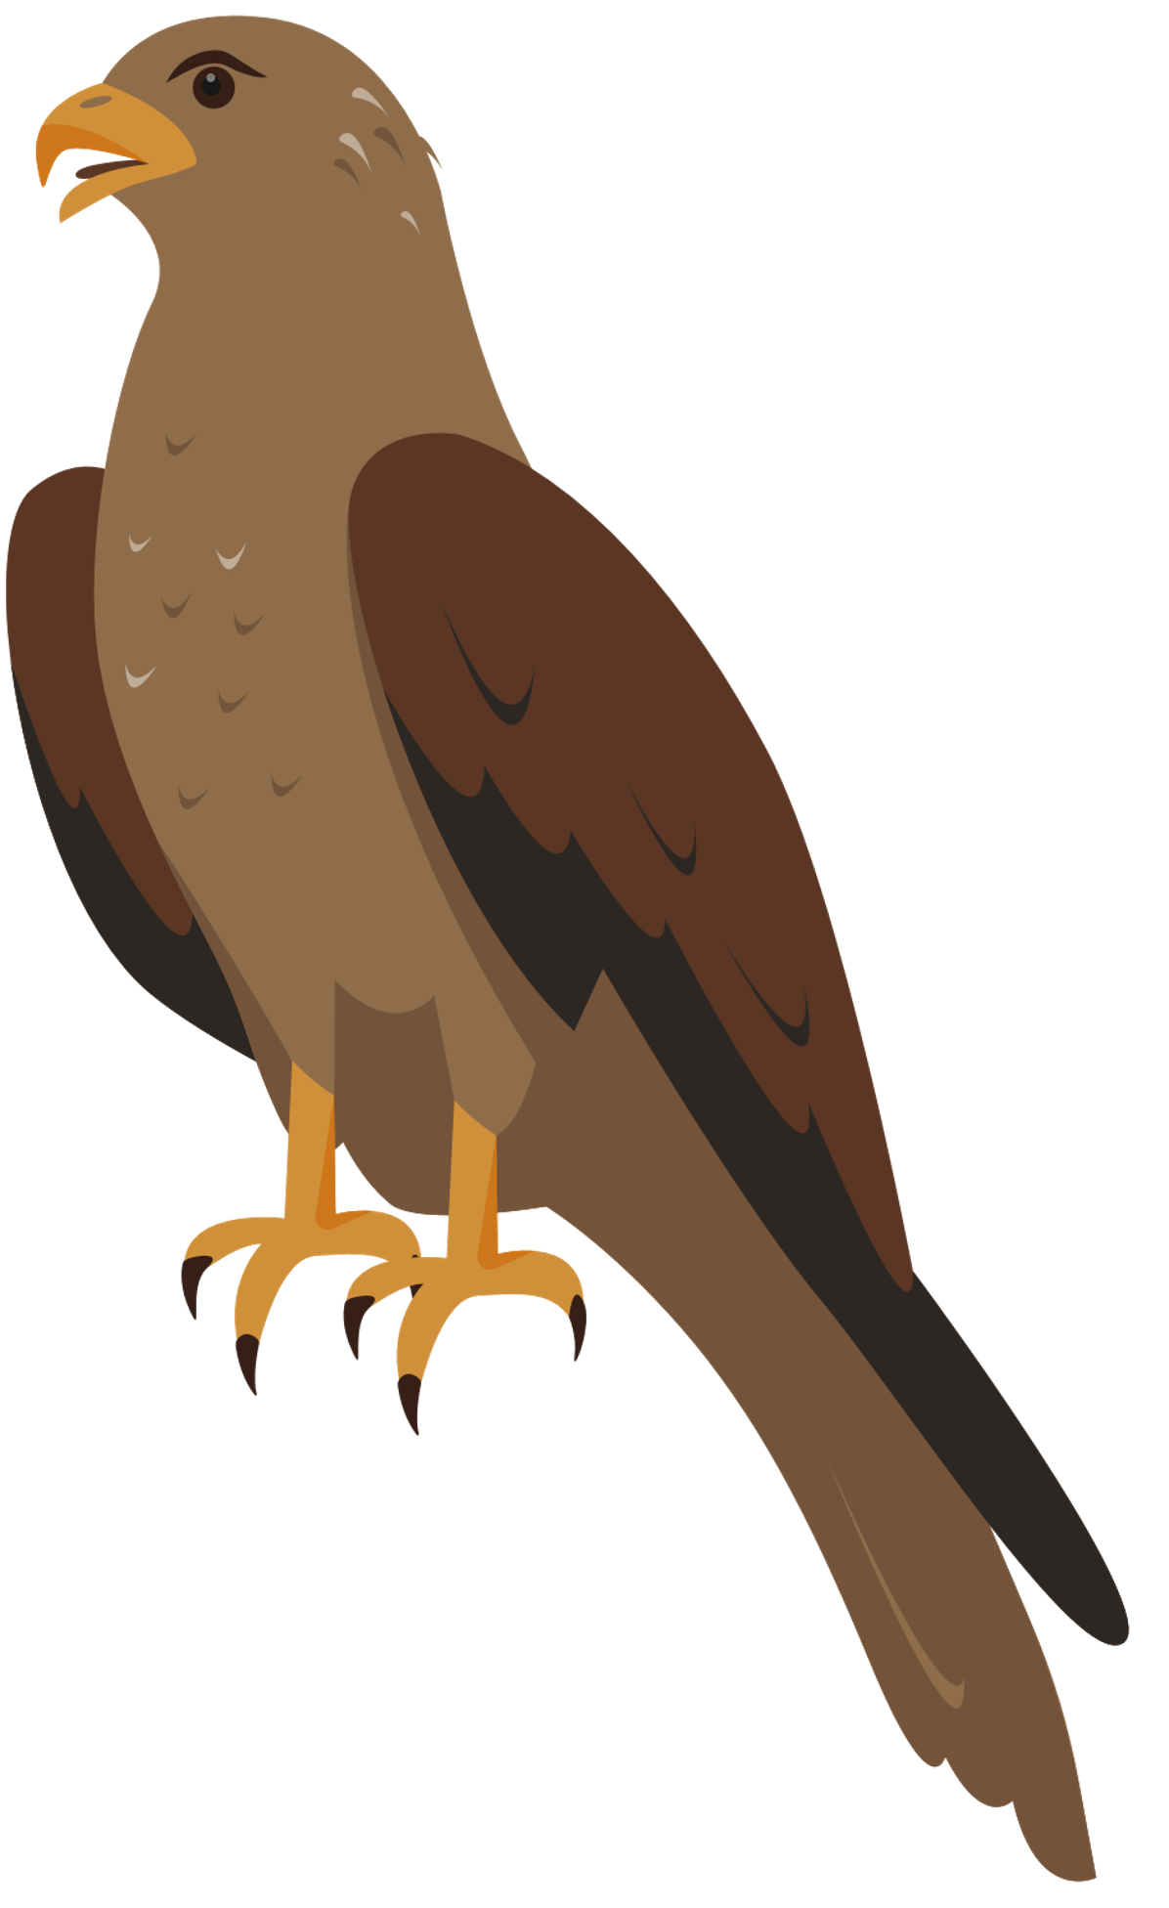
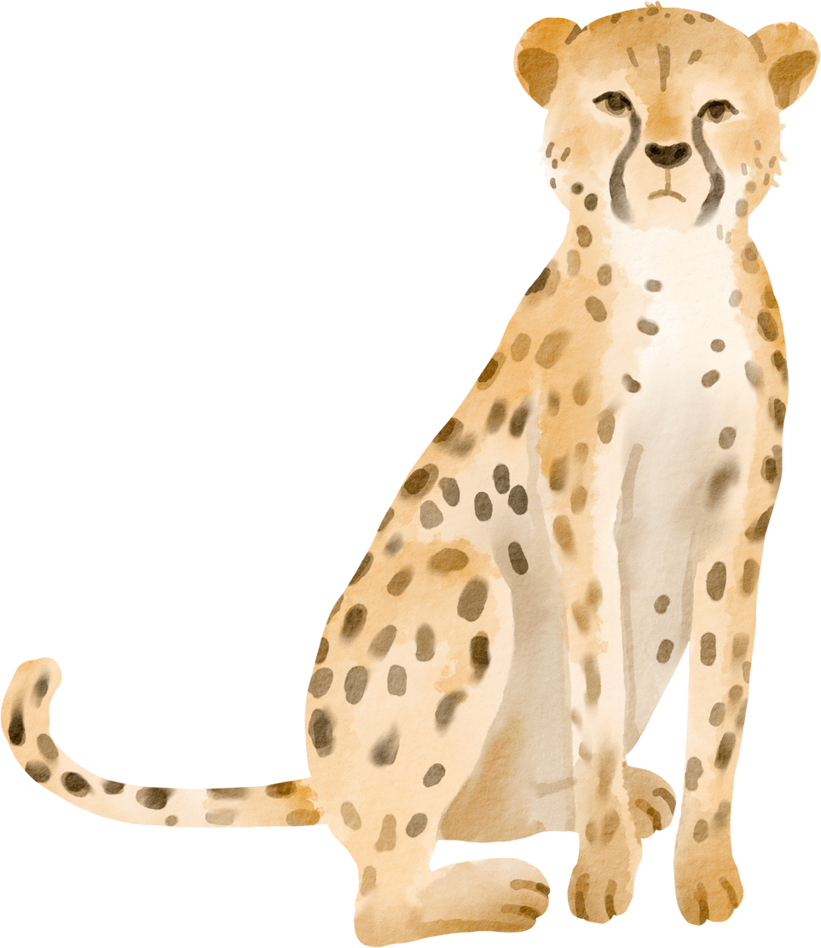
COMPARATIVE ADJECTIVES
The cheetah is faster than the lion.
The eagle is more majestic than the hawk.
The shark is scarier than the dolphin.

Slide 8
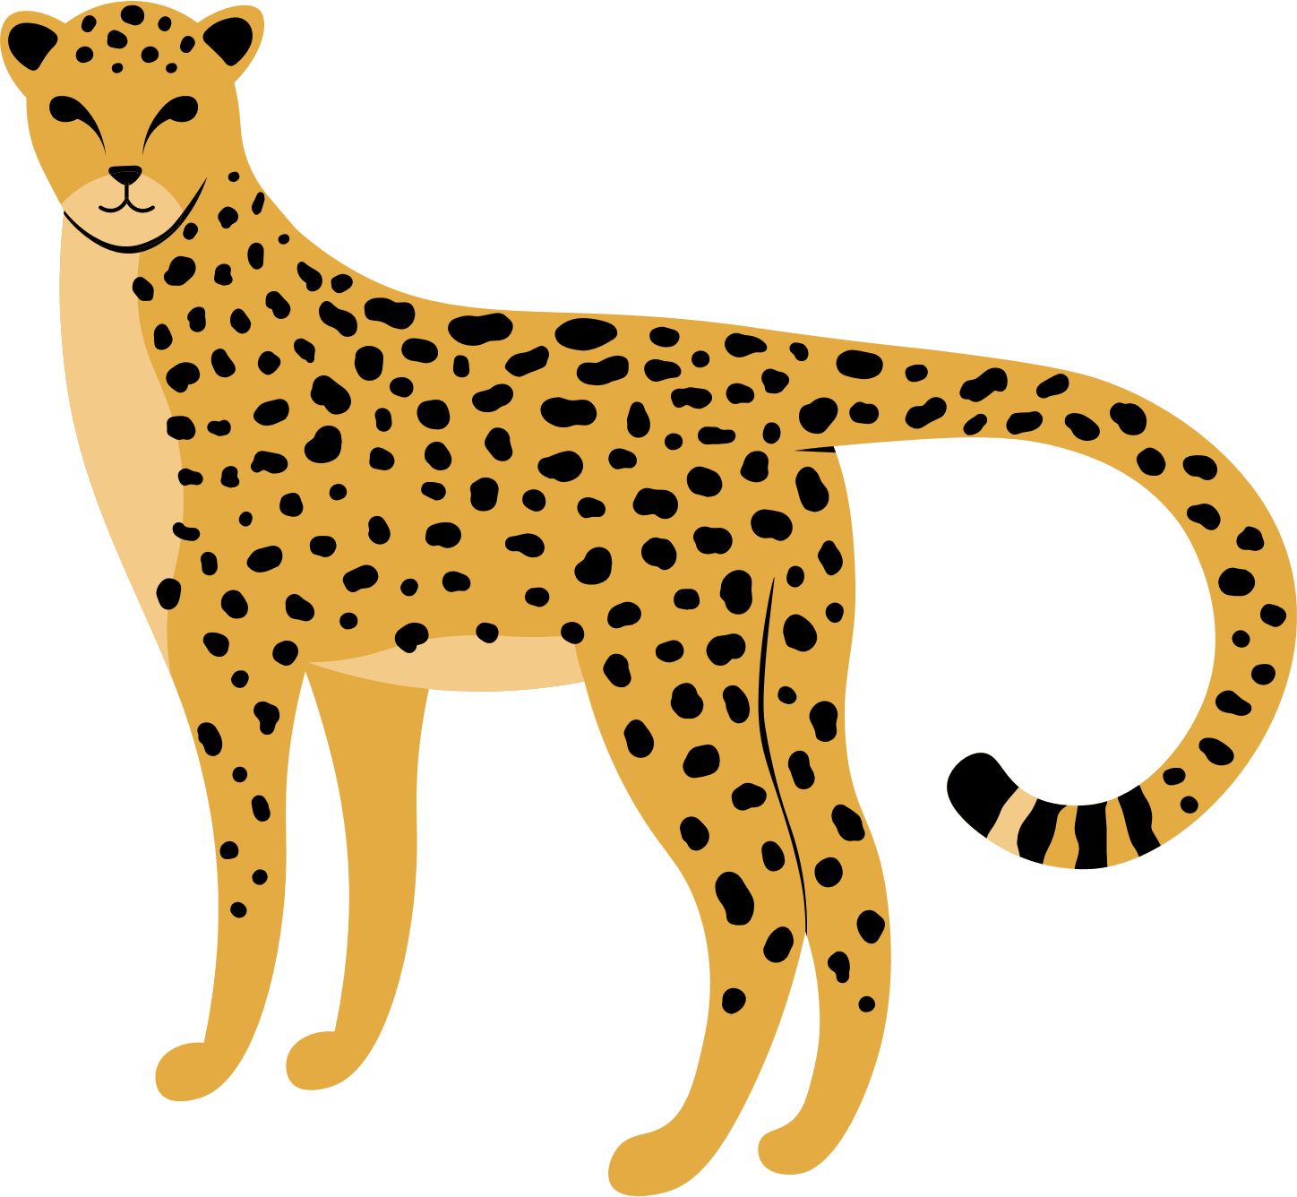
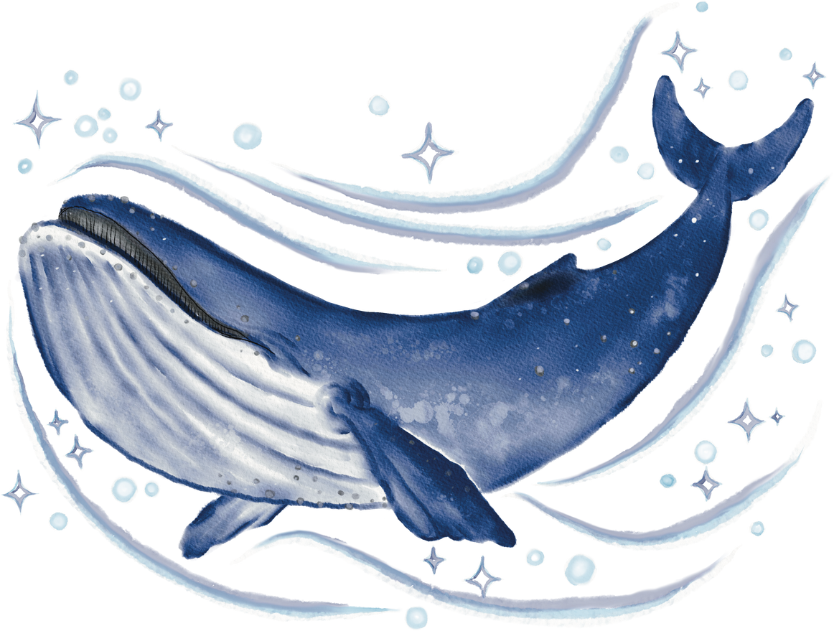
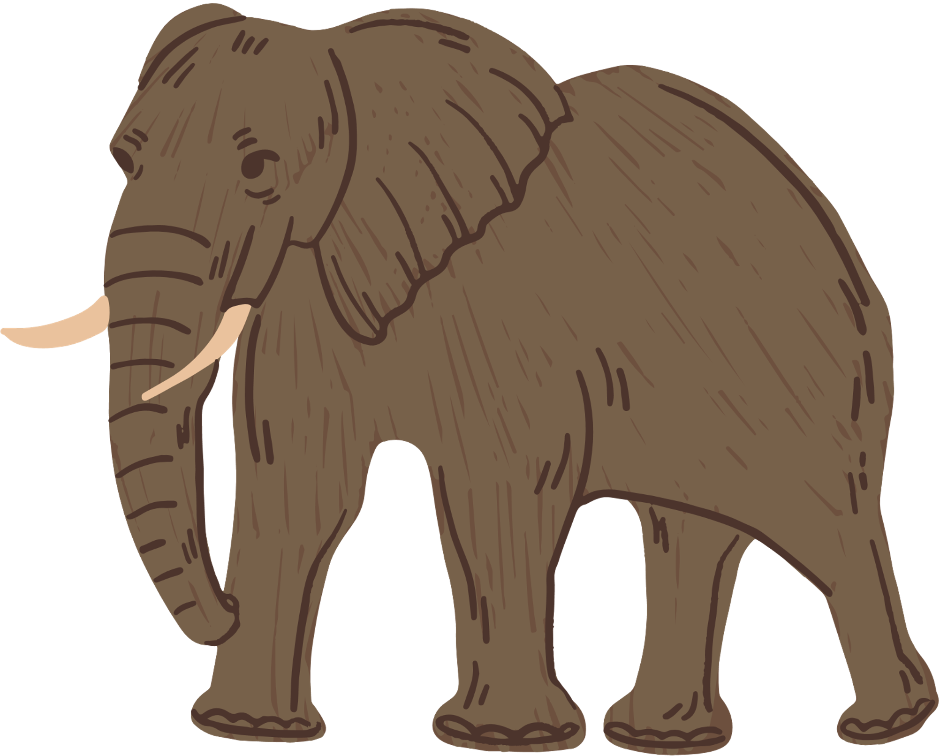
SUPERLATIVE ADJECTIVES
The cheetah is the fastest animal in the world.
The elephant is the largest land animal.
The blue whale is the most massive creature on Earth.

Slide 9
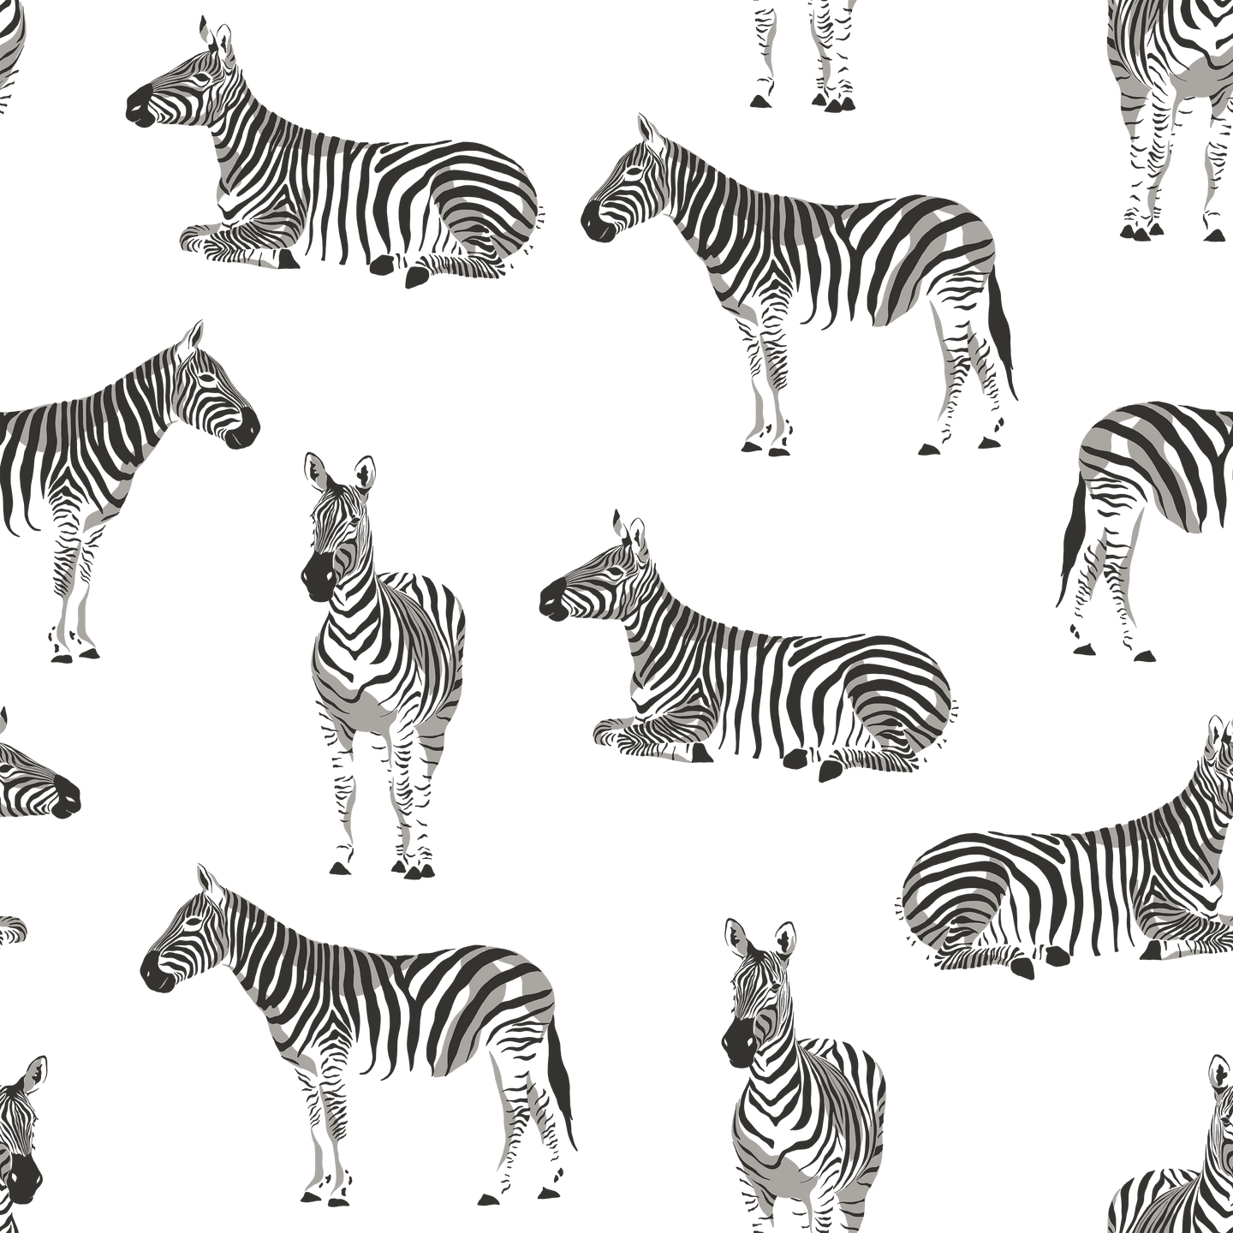
Thank you for listening!

